Slide 1

Real Estate Focused Web Crawler For New House Development
Team:
Hemendra Singh Choudhary (hsc4@illinois.edu)

Slide 2

Agenda
Limitation Of General Crawling
How this is different then existing crawling
Customization Of Classifier or/and Crawler
Demo
Future work
Overview

Slide 3
Limitation of Existing Crawlers
Normal crawler looks only for anchor text. It does not look for document contents, page title etc.
Low page ranking for document which does not update and less reference.
Crawling is not focused on specific domain.

Slide 4
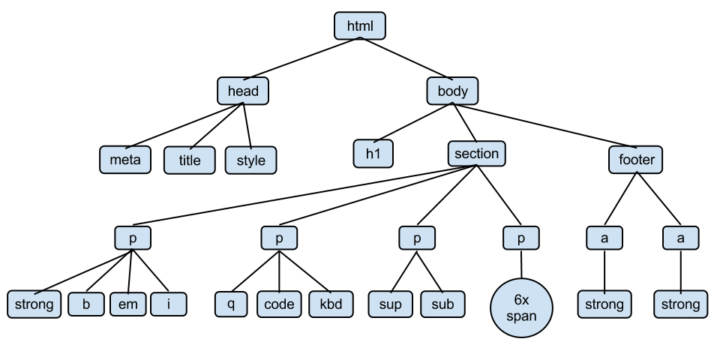
How this is different then existing crawling
Use anchor text, page title and page content to decide if given data is relevant to particular domain
It has a classifier which classify page relevance.
Classifier generates relevance score between 0 to 1
O – implies that web page is not relevant
1 – implies that web page is most relevant
It adds priority in the crawling. Most relevance page will crawl first.

Slide 5
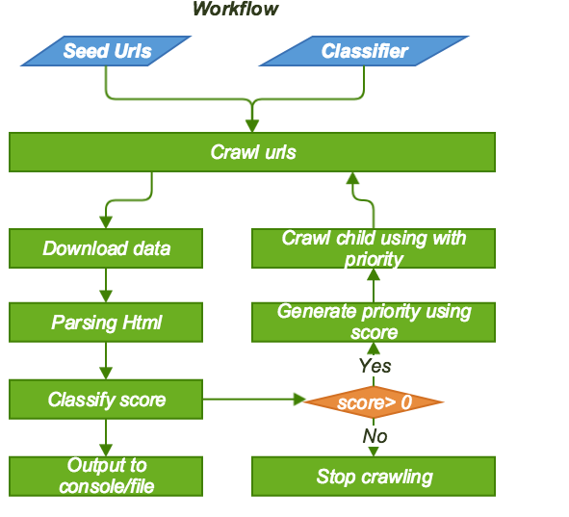
Overview
Take seed urls as input of the script
Crawl pages asynchronously and based upon priority
Once page is download and its parse link, link text (anchor text), page title, page contents
Classify generate a score
Priority of child pages is based upon relevance score
Stop crawling pages if relevance score reach to zero
Output of crawling print out to console as well as puts in files under output folder

Slide 6
Customized Classifier or/and Crawler
Customized Classifier
Classifier can be customized. You can passed any classifier to crawler
Inherit WebClassifier class
Implement getClassifier and score functions
Pass instance of classifier in initialization of crawling
Customized Crawler
You can define different crawler for different domain. It called as spiders.
Place own spider under focused_scrapy_crawler/spiders

Slide 7
Demo
Clone the code - Github source code
Install Dependencies (Refer README.md for more information)
python 2.7.3 and above.
scrapy 1.4.0
metapy
Beautiful Soup version 4
Go to folder focused-web-crawler then run the following command python run.py seed_url1,seed_url2
Example - python run.py http://newhomesource.com,https://en.wikipedia.org
Print output at console as well as put in the output folder
output/newhouse_output_all - hold all crawled urls with their relevance score.
output/newhouse_output_positive_score.txt - hold crawled urls where score is greater than zero

Slide 8
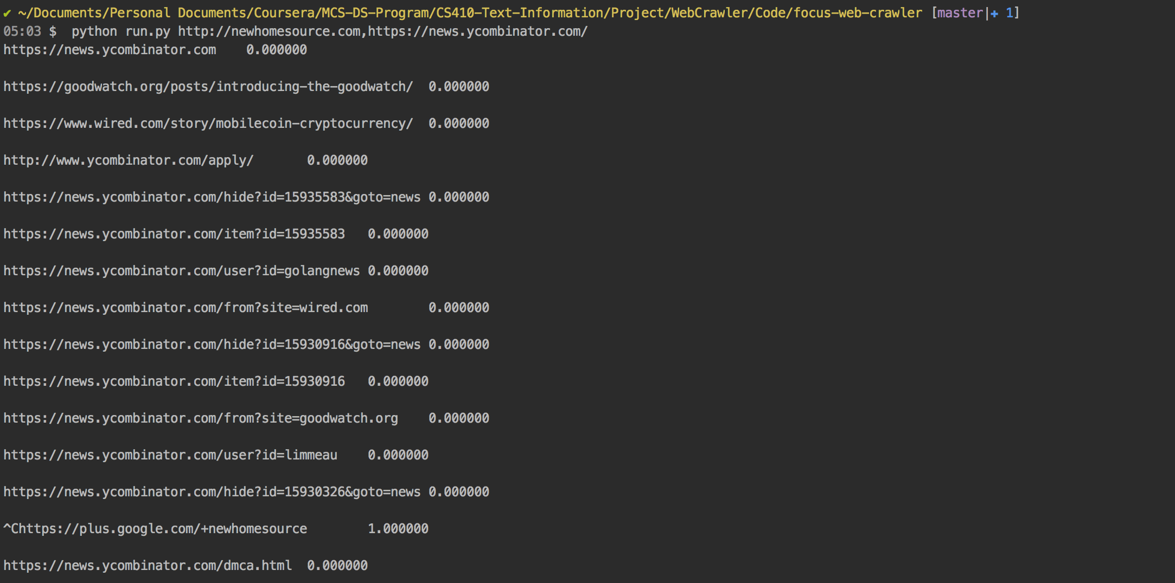
Example

Slide 9
Future Work
Evaluation of classifier
We can extend project and add evaluation of results of classifier
Improve classifier
We can improve classifier and output score between 0 and 1 instead of only 0 or 1
Add page ranking algorithm
We can add ranking algorithm to improve output result
Persistence state of crawler
Right now, crawler does not support persisted state between two runs. You can extend this project by implementing persistence state of crawler so it can resume the work from previous state.
Refine training data set
Since this is manual defined training set, it has lot of scope to improve

